Slide 1
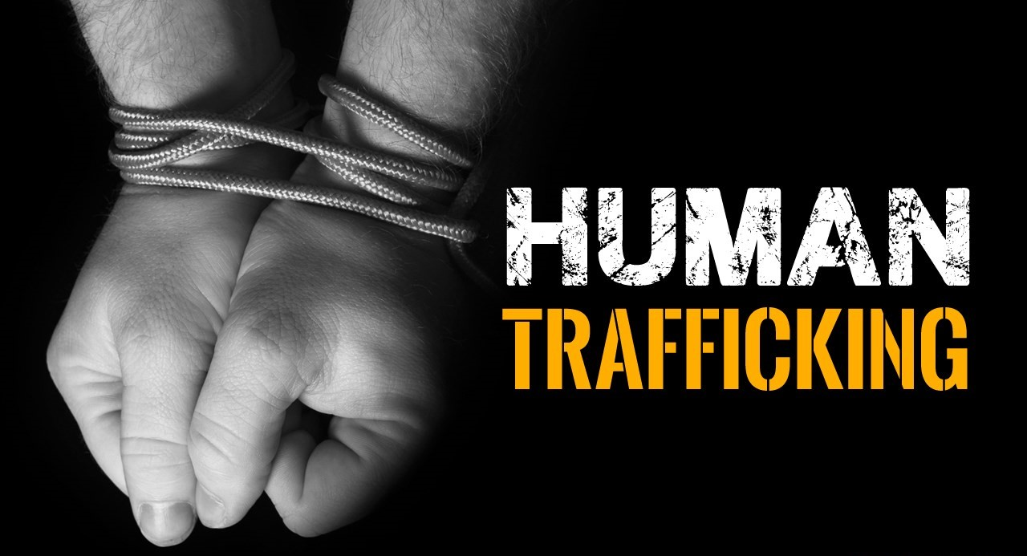
TEAM MEMBERS:
RA2011003011207 ARYAN KAROLIWAL
RA2011003011250 ESHA MISHRA
RA2011003011251 ADITYA GIRI GOSWAMI
RA2011003011252 DIVYANSH GUPTA
RA2011003011253 PURVA ATUL TARALE

Slide 2
About Human Trafficking
Human trafficking, form of modern-day slavery involving the illegal transport of individuals by force or deception for the purpose of labor, sexual exploitation, or activities in which others benefit financially. Human trafficking is a global problem affecting people of all ages.
Human trafficking in India, although illegal under Indian law, remains a significant problem. People are frequently illegally trafficked through India for the purposes of commercial sexual exploitation and forced/bonded labor. Although no reliable study of forced and bonded labor has been completed.
Men, women and children are trafficked in India for diverse reasons. Women and girls are trafficked within the country for the purposes of commercial sexual exploitation and forced marriage, especially in those areas where the sex ratio is highly skewed in favor of men.

Slide 3
Victims of Human Trafficking
Victims of human trafficking can be people of any age group and any gender and from anywhere in the world. However, female are primary targets of human trafficking or sex trafficking. Teen age boys and girls are more vulnerable and easily become the victims human trafficking. One in every three victims of human trafficking is a child. Girls are mainly trafficked to work as sex worker, while boys are trafficked for forced labor in dangerous industries.
Traffickers target people who are in difficult circumstances, desperate for job, money etc. Victims may be forced or tricked into an exploitative situation through uses violence, deception or blackmail. Children from the poor household, dysfunctional families or those who are abandoned and have no parental care are more vulnerable to human trafficking.

Slide 4
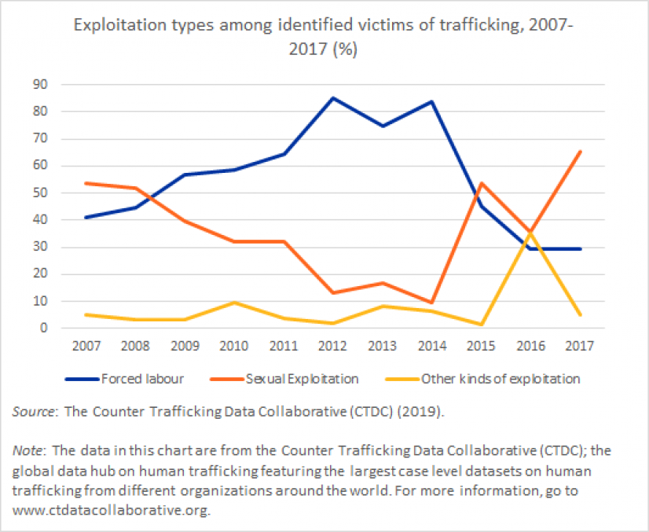
Facts and Figures
Since the early 2000s, the proportion of identified cases of trafficking for sexual exploitation has in general declined, while the share of identified cases of trafficking for forced labor has generally increased, as identification of such cases has improved. However, there are regional differences in the rates of both trafficking for sexual exploitation and forced labor.

Slide 5
Root Causes
Here are some of the major causes of human trafficking around the world:
Poverty: People in poverty are targeted by traffickers, who offer them a way to earn money when, in fact, they will actually earn nothing and be treated as a slave. Poverty also plays a large piece in many of the other root causes of trafficking.
Lack of human rights for vulnerable groups: In many countries, groups that are marginalized in society lack institutionalized human rights, which can lead to them be potential victims of trafficking. A lack of human rights laws can also end in punishment for victims, if the laws and government don’t recognize that human trafficking is exploitation of other people.
Conflict and natural disaster: Conflict and natural disaster can lead to economic instability and lack of human rights, giving traffickers an advantage and making people more vulnerable to human trafficking situations. And with increased economic instability, traffickers have opportunities to offer false job offers to people, leading them into trafficking situations.

Slide 6
Contd…
Social factors and cultural practices: In some places, bonded labor is seen as an acceptable way to pay off debt. In other places, selling children to traffickers is the norm, especially for poorer families in rural areas. Cultural and social factors can also lead victims not to speak up about being trafficked or who their traffickers are, especially if they come from groups who lack human rights protections.
Traffickers: Above many other factors that cause human trafficking are the traffickers themselves. Beyond cultural practices, the profit, vulnerabilities of certain people groups, lack of human rights, economic instability, and more, traffickers are the ones who choose to exploit people for their own gain.

Slide 7
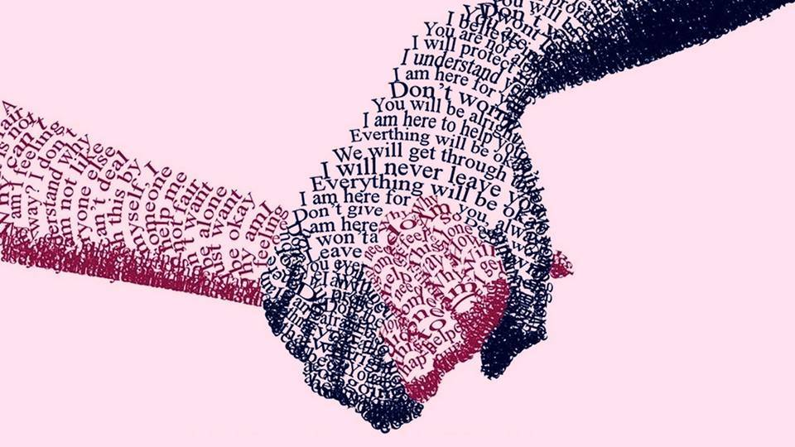

Solutions to Human Trafficking as a Social Issue
Trafficking continues to adversely influence global harmony and security, disrupting economies and compromising the well-being and security of all countries including India.
A few suggestions can be considered to check trafficking.
Reliable data
International cooperation
Inter-departmental convergence
Raise awareness
Incentivizing communities

Slide 8
Detail Execution of Solution
Reliable data: The lack of authentic global data makes it hard for governments and international organizations to battle trafficking successfully. There has to be an immediate strengthening of the information collection system and encouragement of countries to acknowledge and report crimes diligently.
International cooperation: There must be strong international cooperation between law enforcement agencies of different countries and citizens committed to stopping the illicit trafficking of valuable art and antiquities, in-order to bring to light, various hidden deals.
Inter-departmental convergence: As the number of investigating departments increase so do gaps in performance. It is difficult to coordinate and perform effectively unless they operate in convergence for all cases.

Slide 9
Contd…
Raise awareness: Information available on illicit trade has to be brought to light to alert people of how serious the concern is. This gradually shall enable policymakers and investigation agencies around the globe to create strong foundations of effective policy enforcement and an action plan can be formulated for their immediate response to such crimes accordingly.
Incentivizing communities: There are many small-scale, opportunistic traders who are leads to bigger networks. These local traders are easily recognizable among their community and thus the role of locals and communities is inevitable and can be of great help to identify these networks. Incentivizing communities can encourage them to work in association with the authorities and help in making legal efforts more effective.

Slide 10
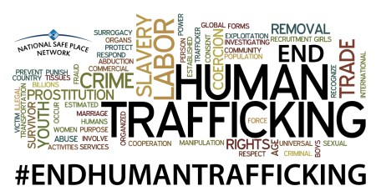
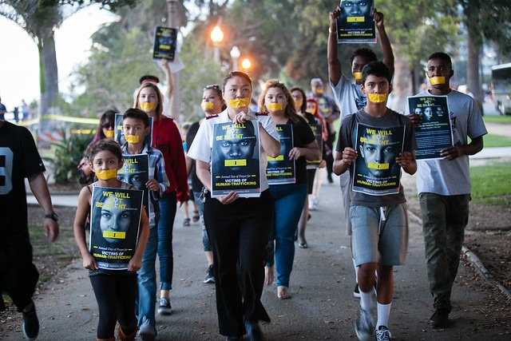
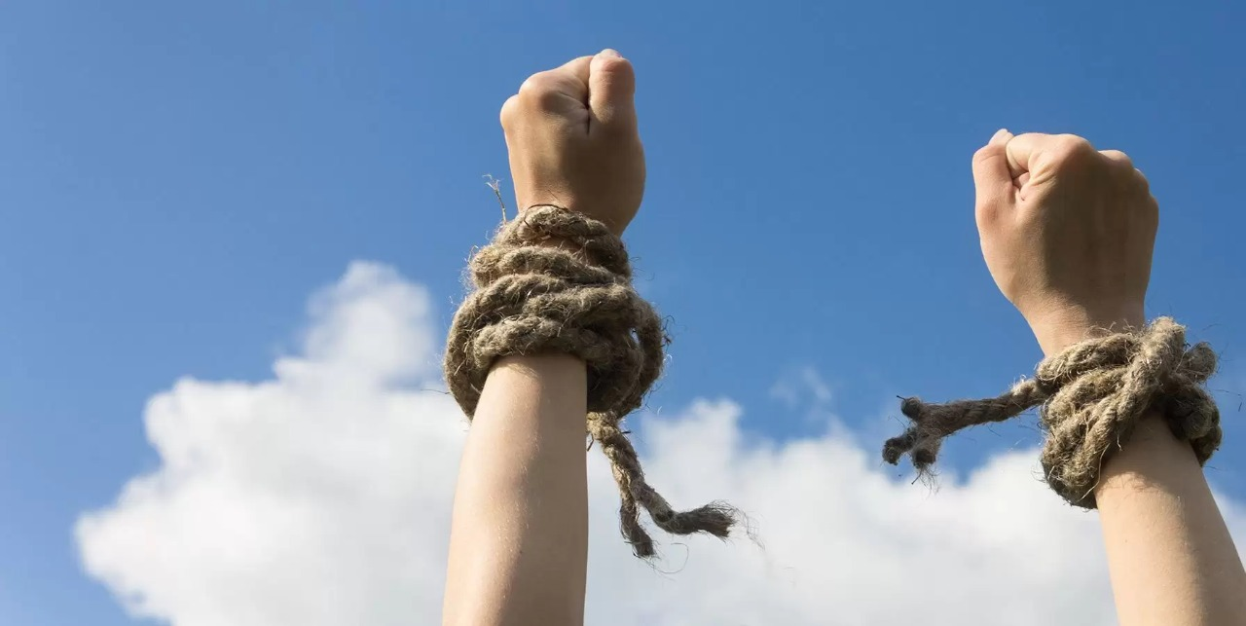
THANK YOU

